Slide 1
The Berkeley Initiative for Transparency in the Social Sciences Onboarding for Undergraduate Research Apprentice Program
Fernando Hoces de la Guardia
February 12, 2021
Notes:
Total time: 10mins

Slide 2
Our Mission
Generate evidence | on problems and solutions through meta-research led by BITSS investigators and our broader community.
Increase access to open science education | building capacity to recognize and conduct transparent and reproducible science through training, access to curricula, financial support, and a growing network of advocates and allies.
Strengthen the scientific ecosystem | enabling researchers and institutions to effectively and equitably change norms at scale through open science policy and protocol development.
Notes:
TED
Highlight new 3 E’s framing

Slide 3
Team Structure
Ted Miguel – Faculty Director
Carson Christiano – CEGA Executive Director
Program Staff:
Katie Hoeberling (Manager
Aleks Bogdanoski (Associate)
Jui Paithane (Intern, 25%)
Research Staff:
Fernando Hoces de la Guardia (Project Scientist)
Lauren Peterson, Emma Ng, Rohan Jha, Max Zhang, Jiayu (Ella) Shi, Keanu Lim, Peter Zhang, Gabriel Kelvin, Sreeja Apparaju (URAPs, 25%)
Notes:
TED
Not much has changed since last year.

Slide 4
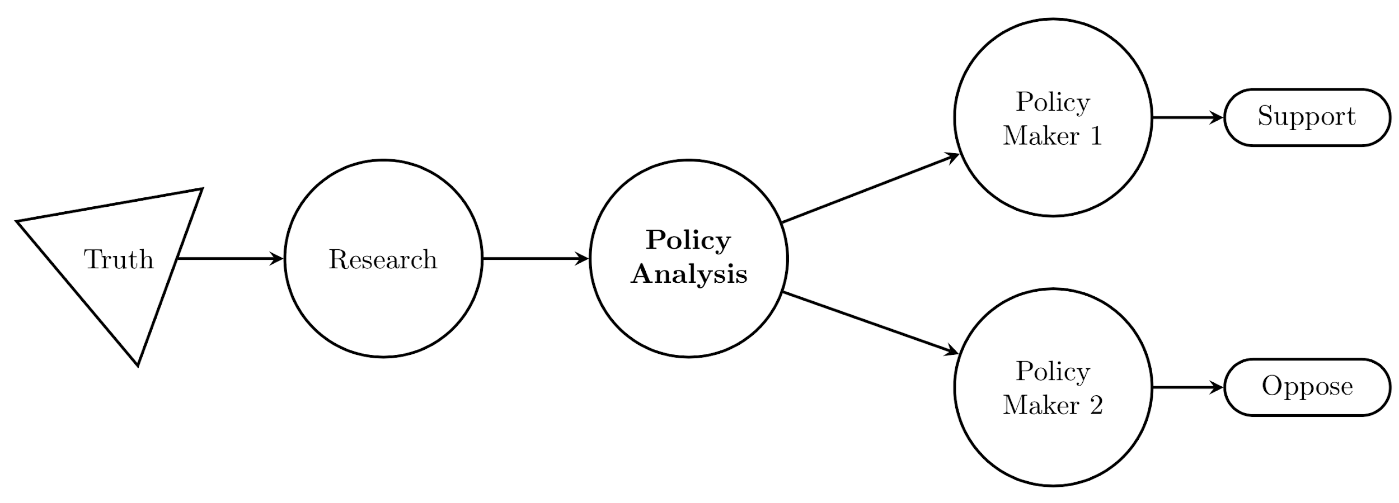
What is the focus of Open Science?

Slide 5
Open Science
Issues:
Scientific misconduct
Publication Bias
P-Hacking
Replications problems
Solutions:
Ethical research
Registrations & PAPs
Guidelines and Protocols
Reproducible workflow

Slide 6
BITSS Previous work
Changing norms: RR at the JDE, best practices at the IDB and INSP, Textbook
Learning: More meta-research: 3S, Citations study
Community building: AM, Catalysts, RT2

Slide 7
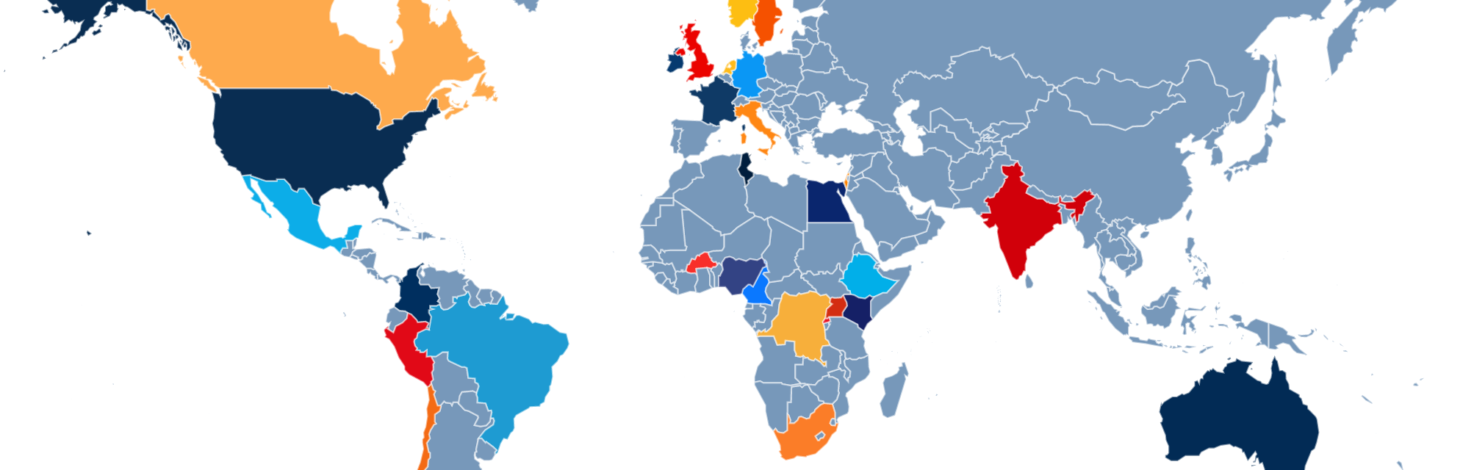
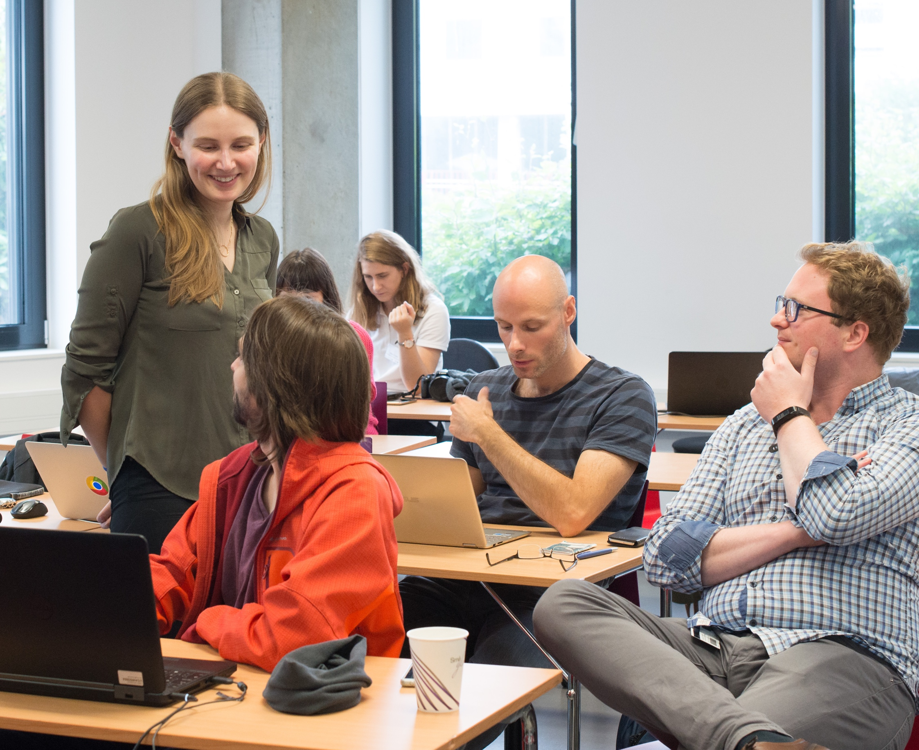
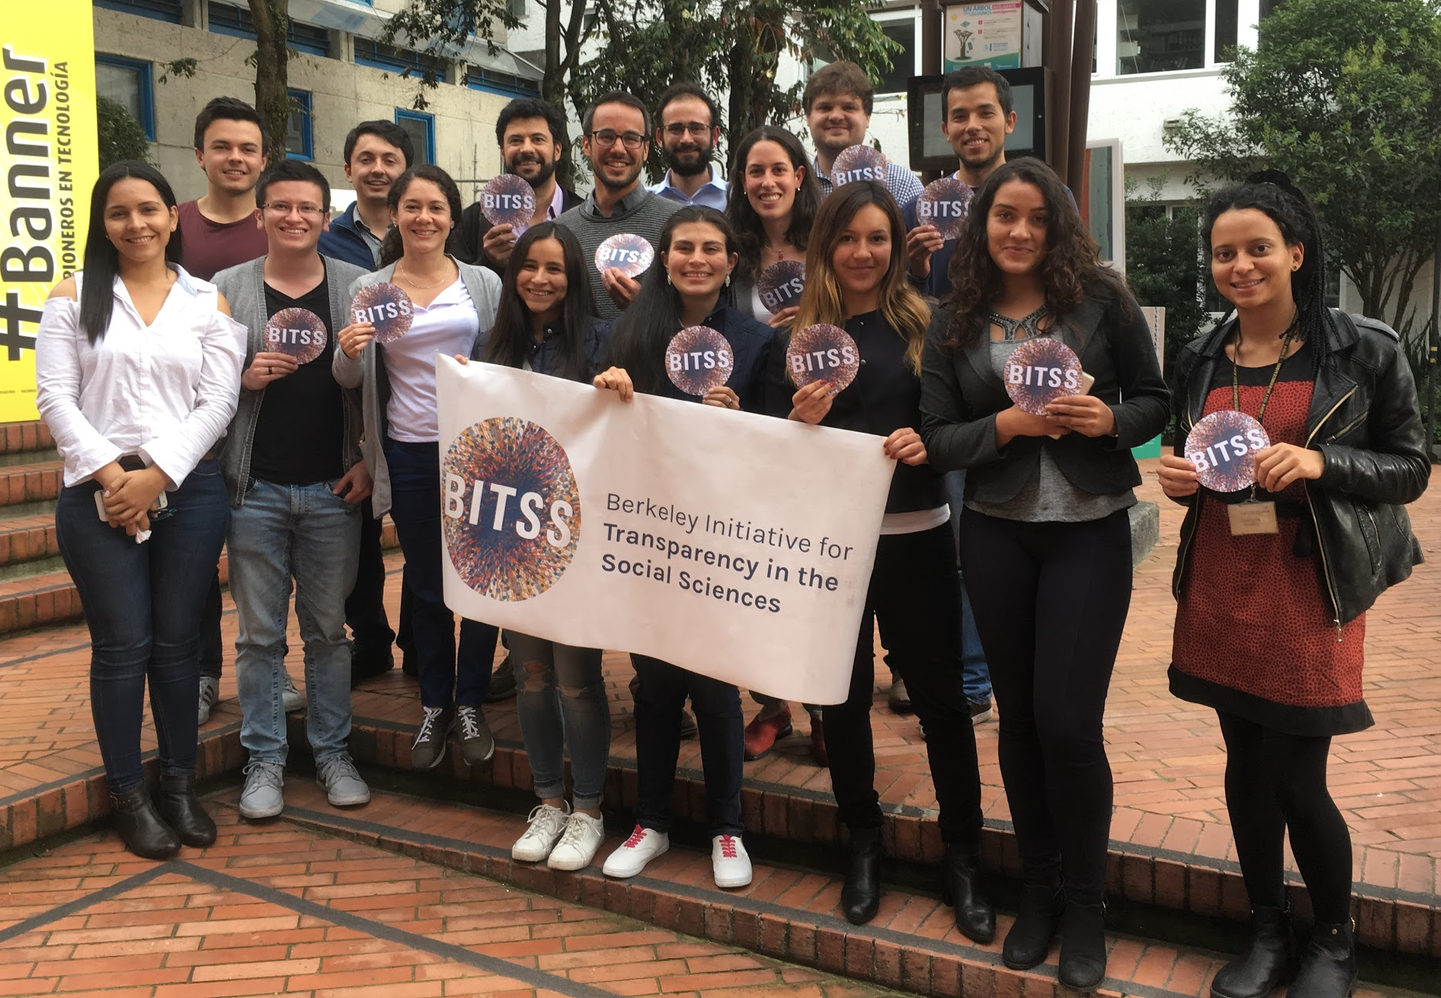
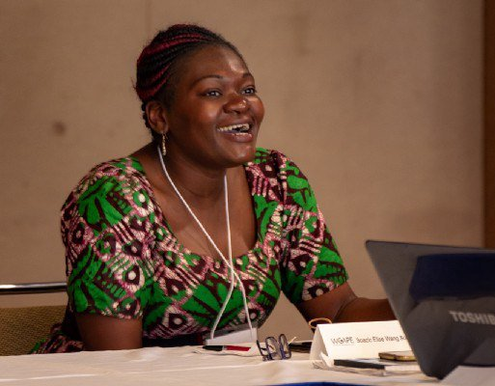
Our Network
BITSS Catalysts are PhD students, faculty, and researchers committed to advancing the teaching, practice, funding, and publishing of transparent and reproducible research.
120+ academics and practitioners;
90 institutions; 30 countries

Slide 8

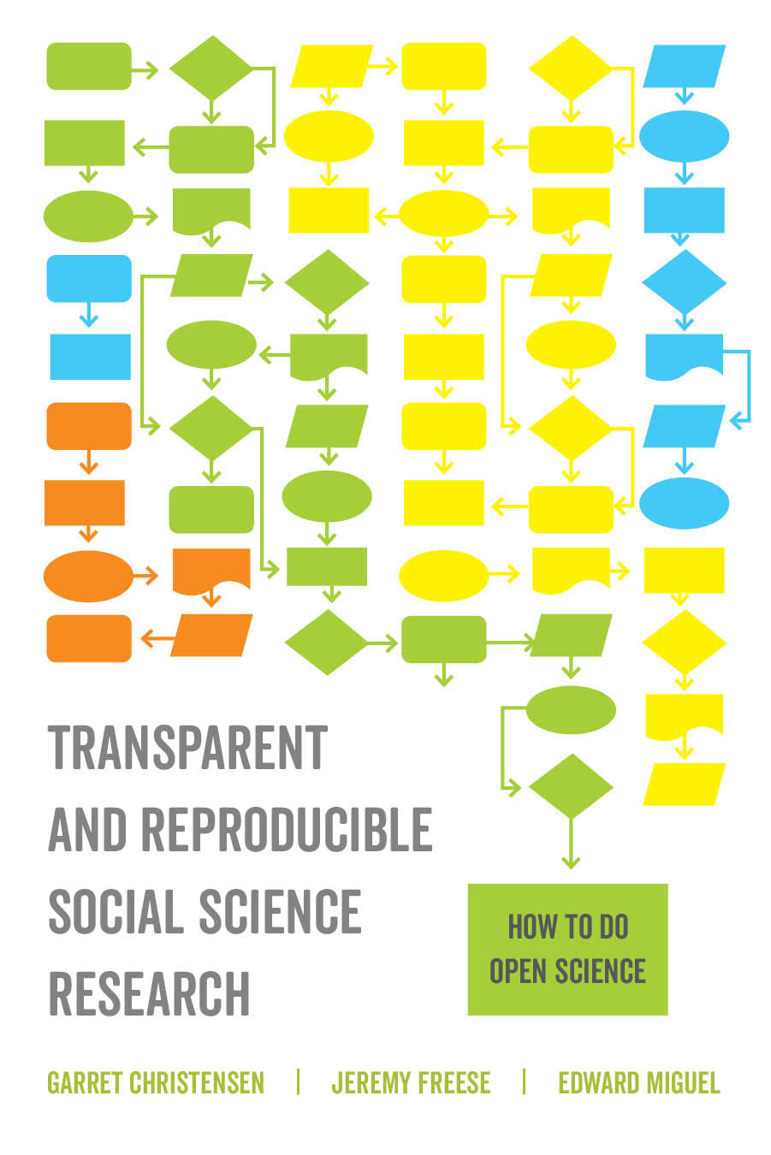
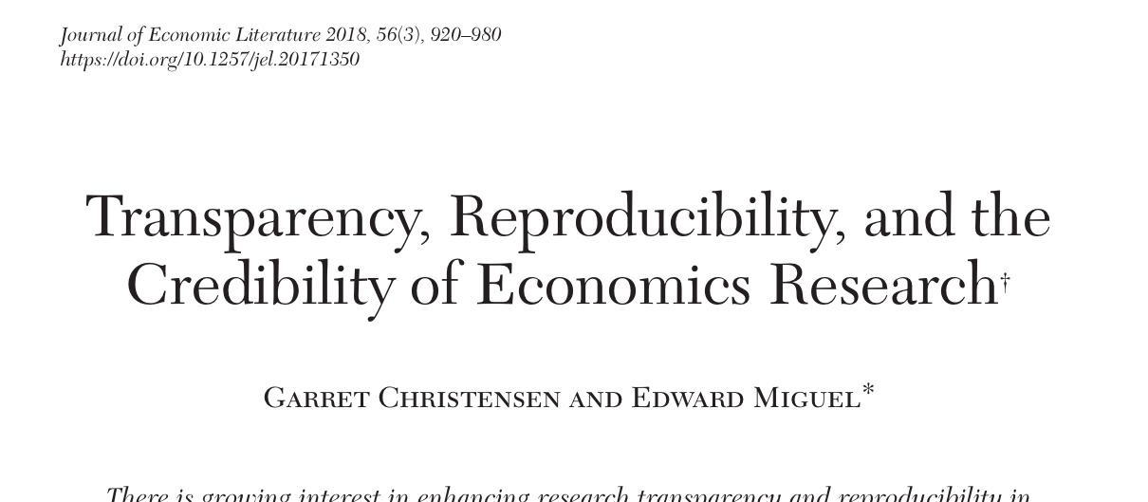
Recent Publications

Slide 9
BITSS Today
Community building: AM, Catalysts, RT2
Super Forecasters in Social Sciences
ACRe computational reproducibility in the classroom and in papers
Open Policy Analysis

Slide 10
Why Bring Open Science into Policy Analysis?

Slide 11








Slide 12



Slide 13
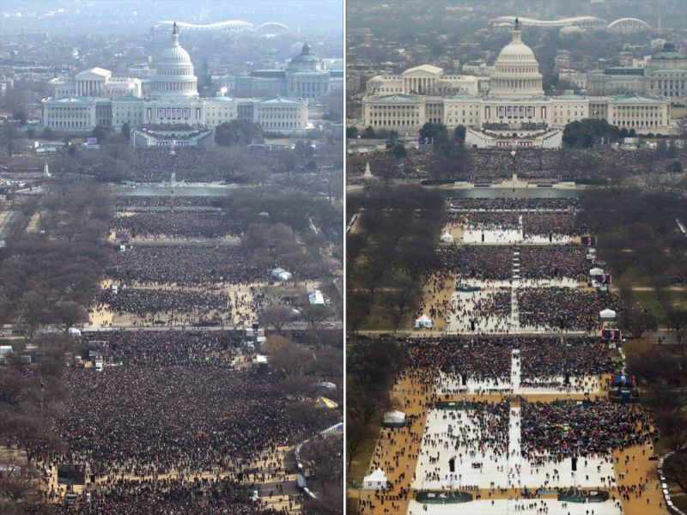
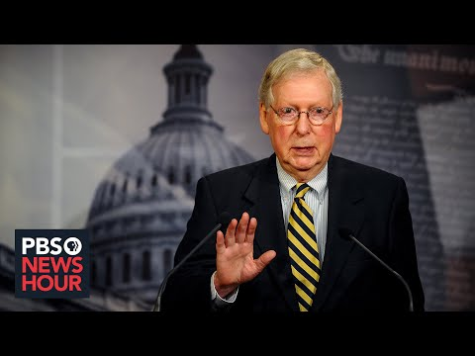
Policy consequences
Each interest group can choose the evidence that they like the most
General public can, and will, disregard evidence
Interviewer: “We I have looked at what economist are saying, and [...] there is no measurable evidence that people are staying at home because of [$600 unemp. insurance]”
Congressman: “[scoffs] I don’t know which economist you are talking about, but ...”

Slide 14
Where can we fix this madness?
Academic economist have large responsibility in this (my view):
Very low bar for rigor and relevance of policy implications of research (“back of the envelope calculation...”)
Large rewards to finding “silver pellets”, but little reward to put them together
Novelty bias
Contempt towards policy economist

Slide 15
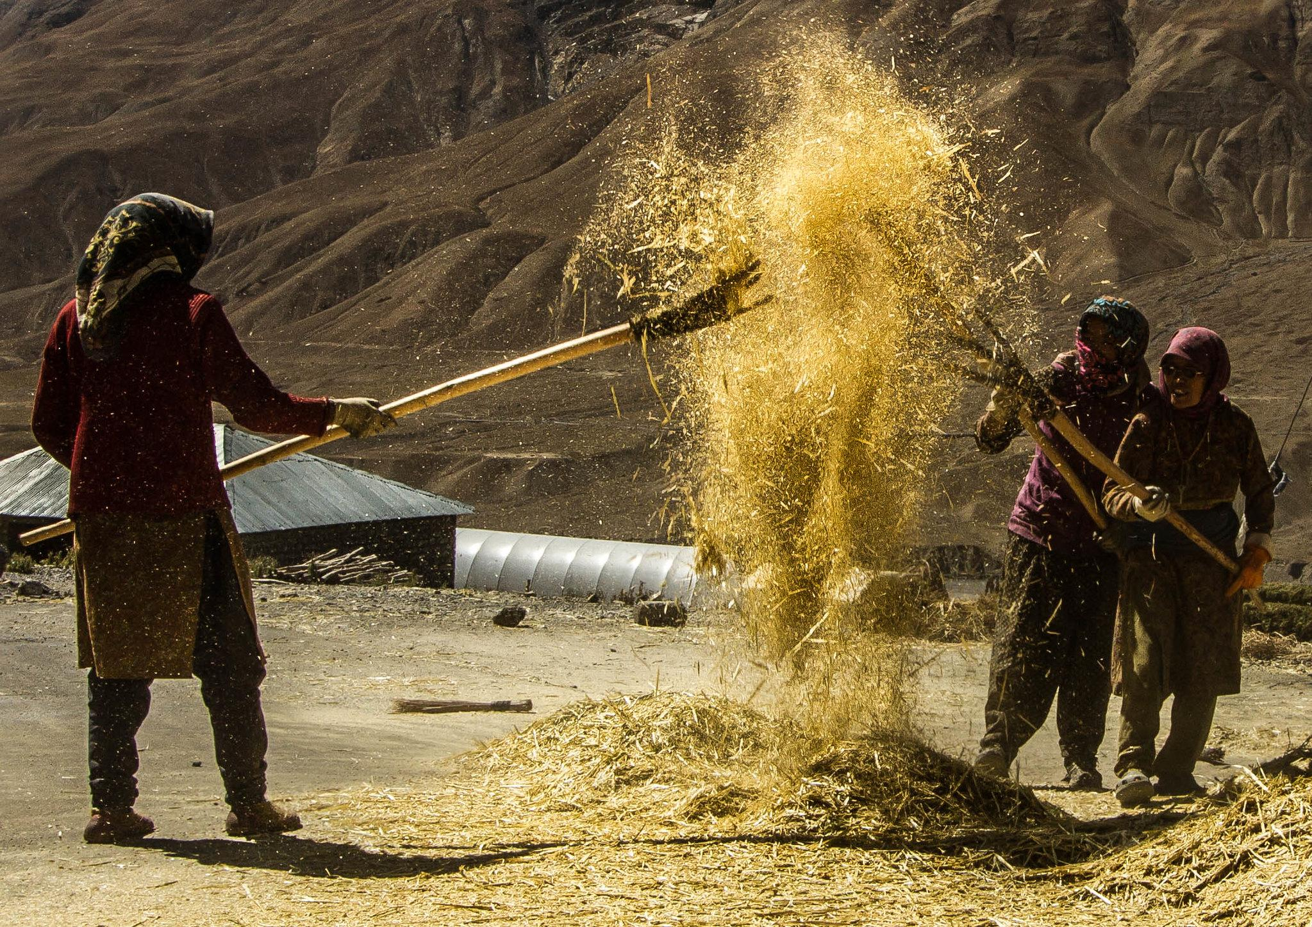
Our proposal:
Open Policy Analysis
To translate the tools and practices of open science into policy analysis
Souvik Chakraborty

Slide 16
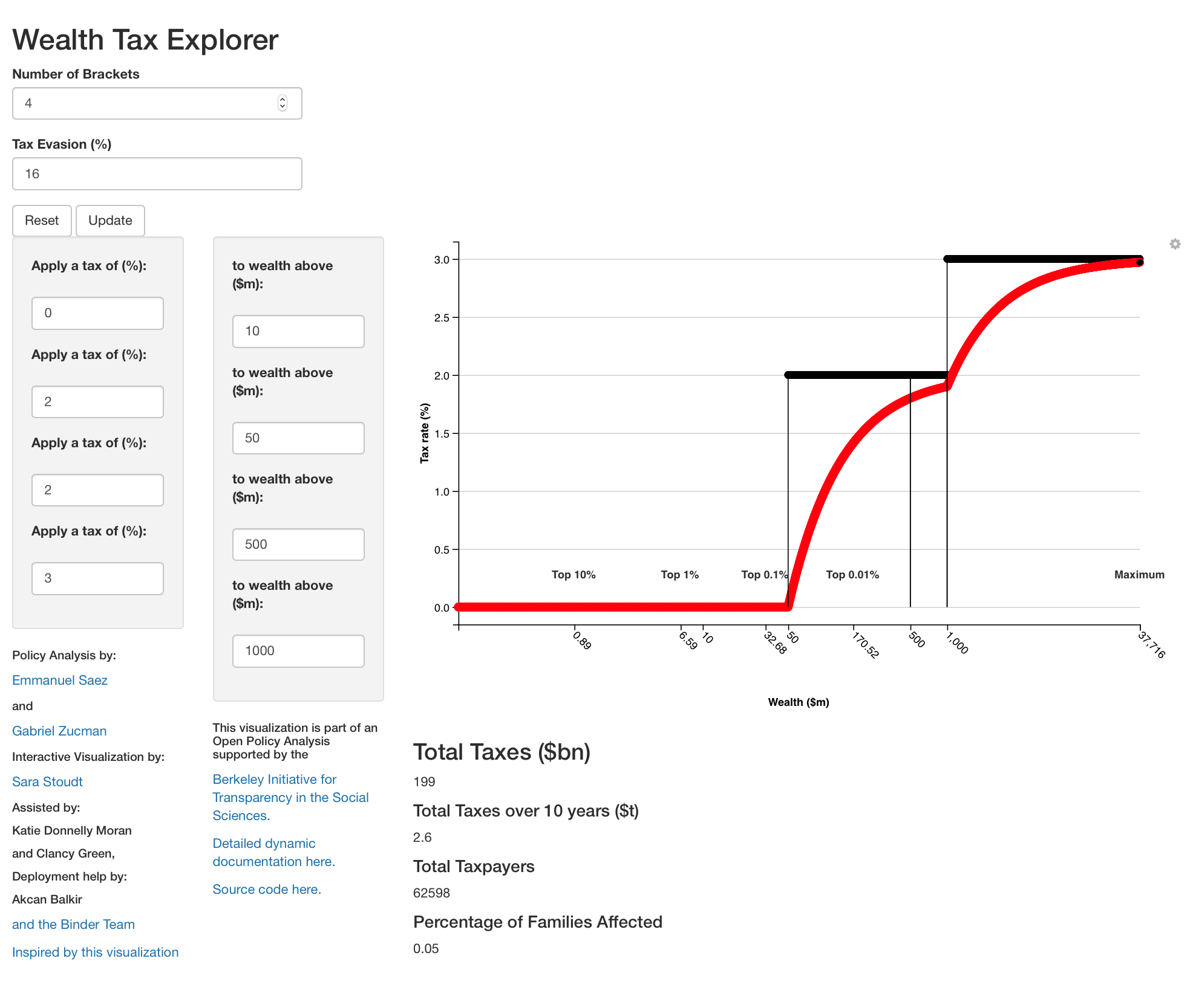
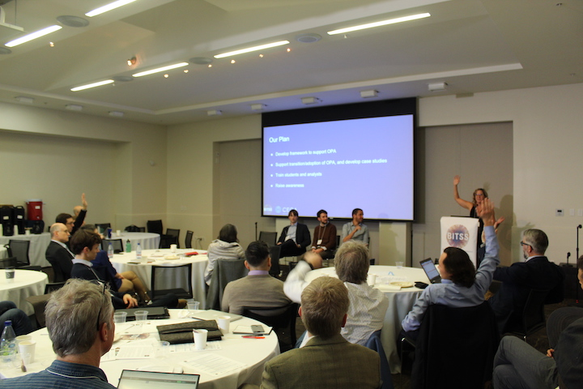
Three Components
Develop and promote a framework
Conduct project demonstrations
Create a community of practice

Slide 17
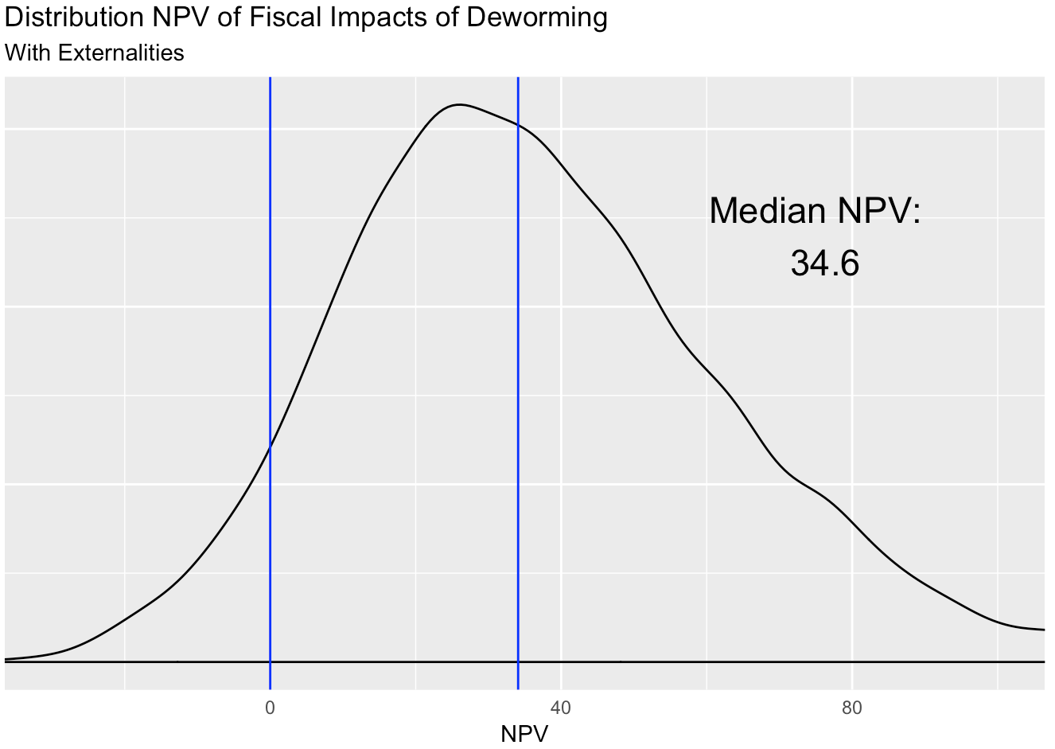
One clear output for policy makers

Slide 18
Clear input-output
link

Slide 19
Complete dynamic documentation

Slide 20
Complete reproducible repository

Slide 21
Our Framework for Open Policy Analysis
- Unified output
- Clear output-input link
Open Output
Open Analysis
Open Materials
Policy Makers
Output
Staffers/Advisors
Assumptions
- Open Code
- Open Data (raw & final)
- Open Report
Policy Analysts & Researchers
All details
Policy Analysts & Researchers
All materials
- Common file structure
- Label data, research, guesswork
- Make code/spreadsheets reproducible
- Use version control

Slide 22
Demo of a completed OPA

Slide 23
Our Plan for OPA
Develop framework to support OPA. Paper here
Support transition/adoption of OPA, and develop projects
Train students and analysts
Raise awareness
Notes:
Develop framework to support OPA
Principles
Guidelines
Support transition/adoption to OPA, and develop case studies
Minimum wage in the US
Deworming in Kenya
Train students and analysts
RT2-type of curriculum (policy/economics)
Raise awareness
This panel
Future convenings
Ongoing presentations (so far APPAM, Evidence Action, GSPP, EDI, GiveWell, AIR, CBO, IDB, AM1)

Slide 24
URAPs for OPA
We are looking to scale-up the footprint of OPA across policy domains.
The goal is to have an ongoing pipeline of projects supporting as many analysts and researchers as possible in the creation of OPAs.
This means increasing capacity in
Strengthening the connection to current policy analyses
Systematizing some of the tasks to “open” a policy analysis
Systematizing some of the visualization efforts
Long term objective: 10+ URAPs per semester.
Your initial experience and output will directly inform the larger initiative.

Slide 25
URAP Timeline
Starts today (2/12). Ends: last day of class (4/30). Up to two weeks off for midterms
Week (~10hrs).
Ideal time split: 30% learning a new skill, 40% applying that skill, 30% doing something repetitive and no-so stimulating.
Short semester: 11 weeks.
1 – 2: mainly training. 3 – 10: mainly adding content (ends 11/30!). 11: Summarizing, developing guidelines for future URAPs.

Slide 26
URAP Standard Operating Procedures (SOPs)
End of the week submit a pull request with :
Activities assigned.
Activities performed.
Good examples: learned git, learned R, learned about PA, summarized # reports, pushed # commits, clean shiny app code, support a fellow URAP, etc.
Bad examples: apologies, promises, comments, etc. Will be counted as not submitted.
The number of hours worked.
Track-level team meetings each Monday.
Once a month (March, April): present to the whole team. Set time now.

Slide 27
URAP tasks
Two tracks: Data Visualization (+ Data Science) for Public Policy (DVPP), Policy Policy Outreach and Research (PPRO).
PPRO: Lauren, Emma, Rohan, Max
DVPP: Ella, Keanu, Peter, Gabriel, Sreeja
All tracks must learn how to use Git/Github at a basic level (clone, commit, push, pull) and read this paper.
DVPP: spend first week(s) learning R (screencasts), learning Shiny (book) and reviewing these files.
PPRO: spend first week(s) learning about the wealth tax, deworming (section 5 of this paper) and reviewing the deworming OPA.

Slide 28
URAP Resources
Onboarding materials
Tutorials
OPA template
Policy analysis registry
As you make progress here at BITSS, you are expected to contribute to these resources

Slide 29
Main Tasks
ACRe
All Tracks:
- Conduct computational reproductions of papers in social sciences to beta-test socialsciencereproduction.org
OPA
PPRO:
Read and classify policy analysis into the policy analysis data base
Review analysis and documentation behind current OPAs: soon starting unemployment insurance in the US
DVPP:
Review previous OPA and suggest improvements.
Support the development of the UI OPA.

Slide 30
What to do when you have questions
Administrative questions: email Aleks.
Programing questions: (1) stackoverflow/web (2) your teammates (3) me.
Policy analysis/Methods questions: me/web.
Questions to me: email/weekly meeting.

Slide 31
Git/GitHub Tutorial
Remember to record!

